Slide 1

307304 Business Intelligence and Data Mining
Simple Linear Regression

Slide 2
Topics and Learning Outcomes
What You'll Learn:
Introduce the concept of supervised learning
Understanding regression analysis fundamentals
Types of linear regression models
Best-fit line, hypothesis function, and OLS method
Closed-form solution implementation
Gradient descent algorithm
Linear regression assumptions
Evaluation metrics and performance assessment
Practical implementation with scikit-learn
Linear Regression Assumptions

Slide 3
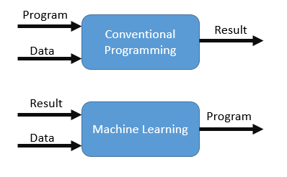
Machine Learning
Concept: ML is the engine behind most AI, allowing systems to learn from data without explicit programming.
How it works (simplified):
Data Input: Provide historical data with known outcomes.
Learning: Algorithm identifies patterns and relationships.
Prediction/Decision: Uses learned patterns on new data to make informed decisions or predictions.
Why it's transformative: Enables data-driven decision-making at scale, identifies hidden insights, and automates complex tasks.

Slide 4
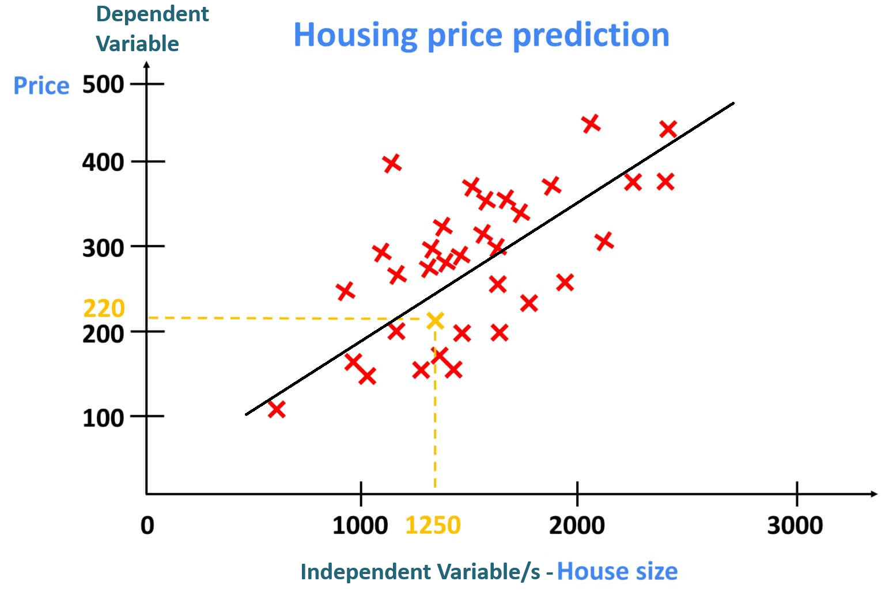
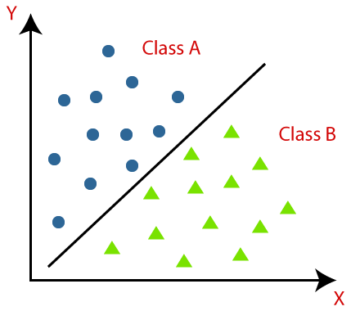
Supervised Learning: Prediction & Classification
Concept: Learning from labeled data (input-output pairs).
1. Regression (Predicting a Number):
Goal: Predict a continuous numerical value.
Business Applications:
Sales Forecasting: Predicting future revenue based on historical sales, promotions, economic indicators.
Customer Lifetime Value (CLV): Estimating the total revenue a customer will generate.
Property Valuation: Predicting house prices based on features.
2. Classification (Predicting a Category):
Goal: Assign data points to predefined categories.
Business Applications:
Customer Churn Prediction: Identifying customers likely to leave.
Credit Risk Assessment: Classifying loan applicants as low/high risk.
Fraud Detection: Identifying fraudulent transactions.
Email Spam Filtering: Classifying emails as spam or not spam.

Slide 5
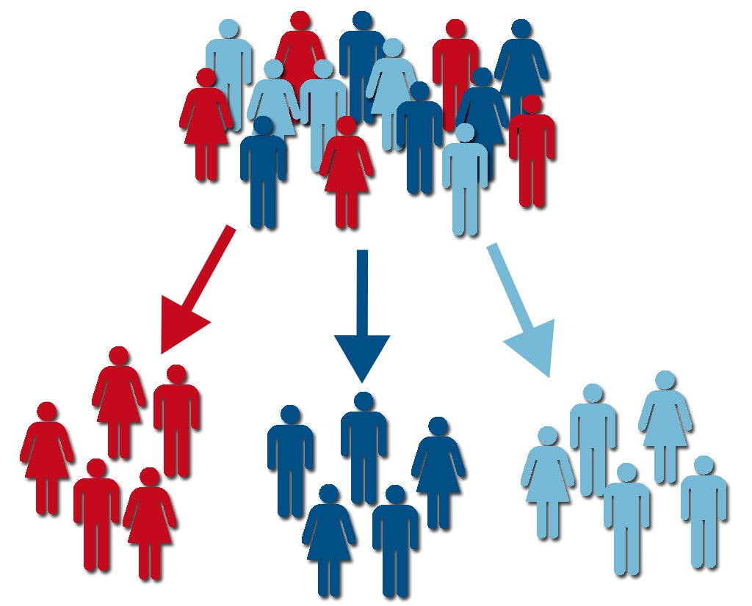
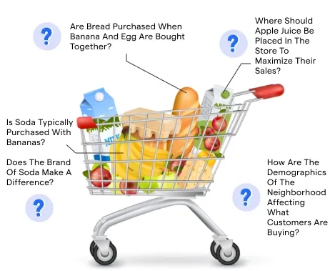
Unsupervised Learning: Discovery & Segmentation
1. Clustering (Grouping Similar Data):
Goal: Discover natural groupings within data. Business Applications:
Customer Segmentation: Grouping customers with similar behaviors/preferences for targeted marketing.
Market Basket Analysis: Identifying products frequently purchased together.
Document Clustering: Organizing large sets of documents by topic.
2. Association Rules Mining (Finding Relationships in Data):
Goal: Discover interesting relationships or patterns between variables in large datasets. Business Applications:
Market Basket Analysis: Discovering items frequently bought together to optimize store layout or cross-selling.
Recommendation Systems: Suggesting products based on association rules derived from user behavior.
Fraud Detection: Uncovering unusual combinations of transactions or events that may indicate fraud.

Slide 6
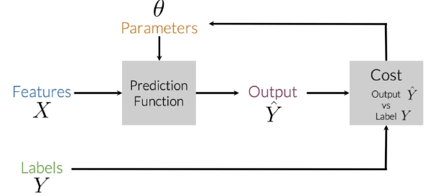
Supervised Machine Learning
Supervised machine learning is a type of learning where a model learns from labeled data.
The process follows these key steps:
Input Features (X): The model takes input data (features) which represents the information used to make predictions.
Prediction Function: The model, with some parameters (θ), processes the input data to generate predictions (Ŷ).
Output (Ŷ): This is the model’s prediction based on the input features.
Cost Function: The predicted output (Ŷ) is compared to the actual labels (Y) to calculate an error or "cost."
Optimization:
The model adjusts its parameters (θ) of the cost function to minimize the error, improving its predictions over time.
This process repeats iteratively until the model achieves good accuracy.
It's commonly used for tasks like classification (e.g., spam detection) and regression (e.g., predicting house prices).

Slide 7
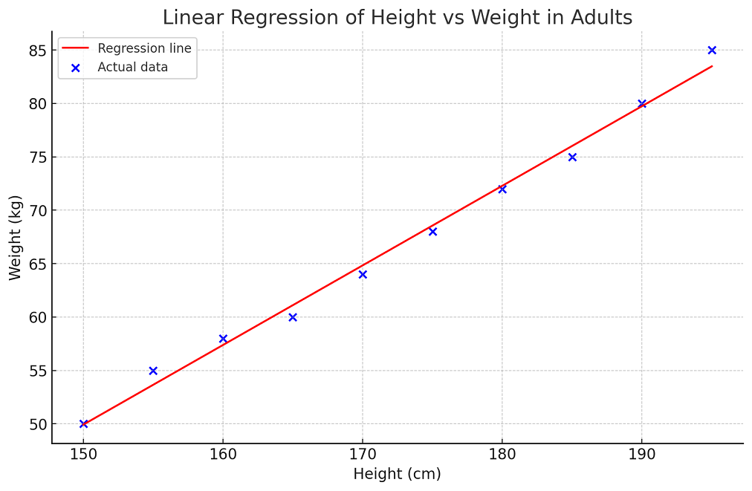
What is Regression Analysis?
Definition and Purpose
Linear Regression is a supervised machine learning algorithm that models the linear relationship between:
Dependent variable (target): What we want to predict
Independent variable(s) (features): What we use to make predictions
Key Concept: Fits a linear equation to observed data to make predictions on new, unseen data.
Real-World Applications:
Predicting house prices based on size
Estimating sales revenue from advertising spend
Forecasting stock prices using economic indicators

Slide 8
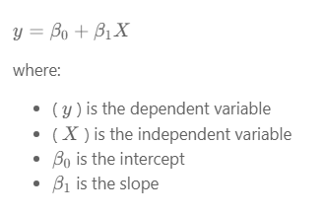
Types of Linear Regression
There are two main types of linear regression:
1- Simple Linear Regression
This is the simplest form of linear regression, and it involves only one independent variable and one dependent variable.
The equation for simple linear regression is:

Slide 9
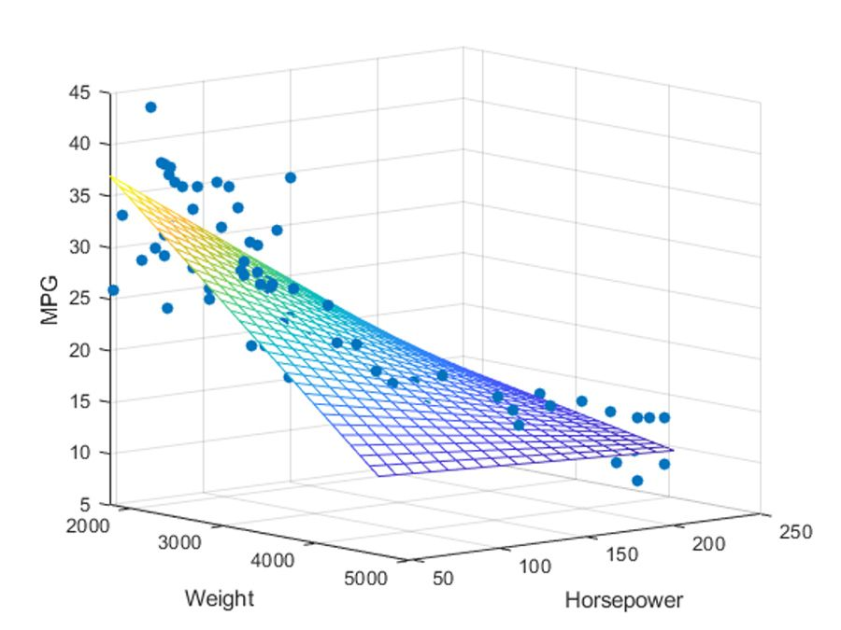
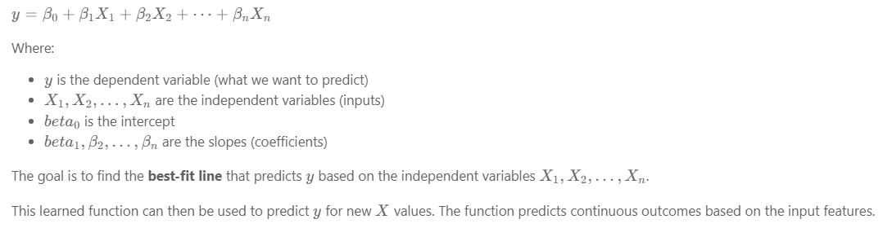
Types of Linear Regression
2- Multiple Linear Regression (Simplified)
In multiple linear regression, there is one dependent variable and more than one independent variable.
The equation is:

Slide 10
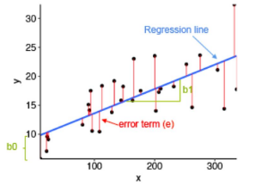
What is the Best Fit Line?
In linear regression, the best-fit line is the line that minimizes the error between the predicted and actual values.
It represents the relationship between the dependent and independent variables.
The goal is to change the slope and the intercept of the line to make the most accurate predictions.
Linear regression predicts Y based on X, using a straight line to model the relationship. For example, X could be work experience, and Y could be salary.
The goal is to find the best-fit line that minimizes the error between predicted and actual values.
To find this line, we use a cost function, which helps determine the best values for the line's coefficients.

Slide 11
Why Linear Regression Matters
Four Key Benefits:
Interpretability
Clear, understandable coefficients
Easy to explain relationships between variables
Simplicity
Transparent and easy to implement
Foundation for more complex algorithms
Basis for Advanced Models
Building block for regularization (Ridge, Lasso)
Foundation for support vector machines
Assumption Testing
Validates key data assumptions
Critical for statistical analysis

Slide 12
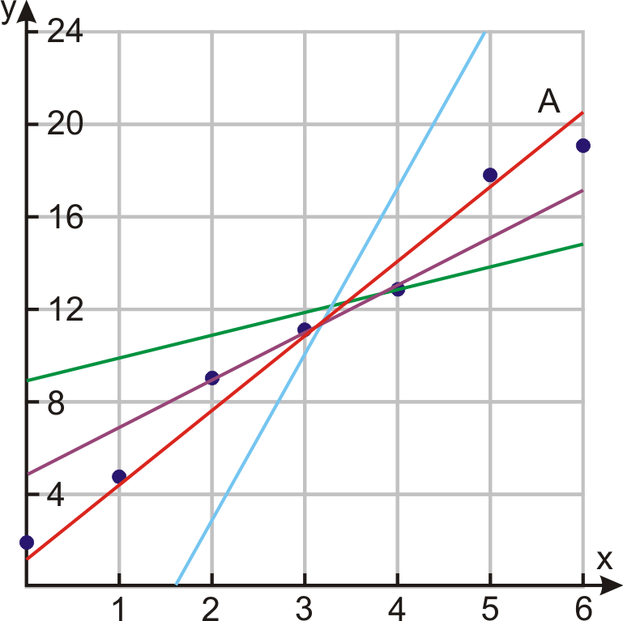
The Best-Fit Line Concept
What Makes a Line "Best-Fit"?
The best-fit line minimizes the error between predicted and actual values.
Key Components:
Slope (β₁): How much Y changes for each unit change in X
Intercept (β₀): Value of Y when X = 0
Goal: Find the line that makes the most accurate predictions
Mathematical Representation: Ŷ = β₀ + β₁X
Where Ŷ (pronounced Y Hat) is the predicted value.

Slide 13
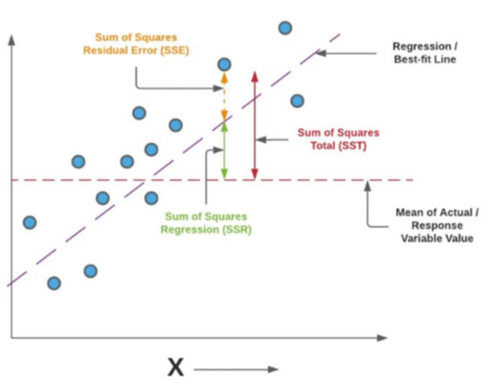
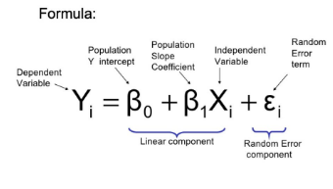
Ordinary Least Squares (OLS) Method
The Foundation of Linear Regression
OLS Principle: Find the line that minimizes the sum of squared differences between observed and predicted values.
Why "Least Squares"?
Squares prevent positive and negative errors from canceling out
Penalizes larger errors more heavily
Provides unique, mathematically optimal solution

Slide 14
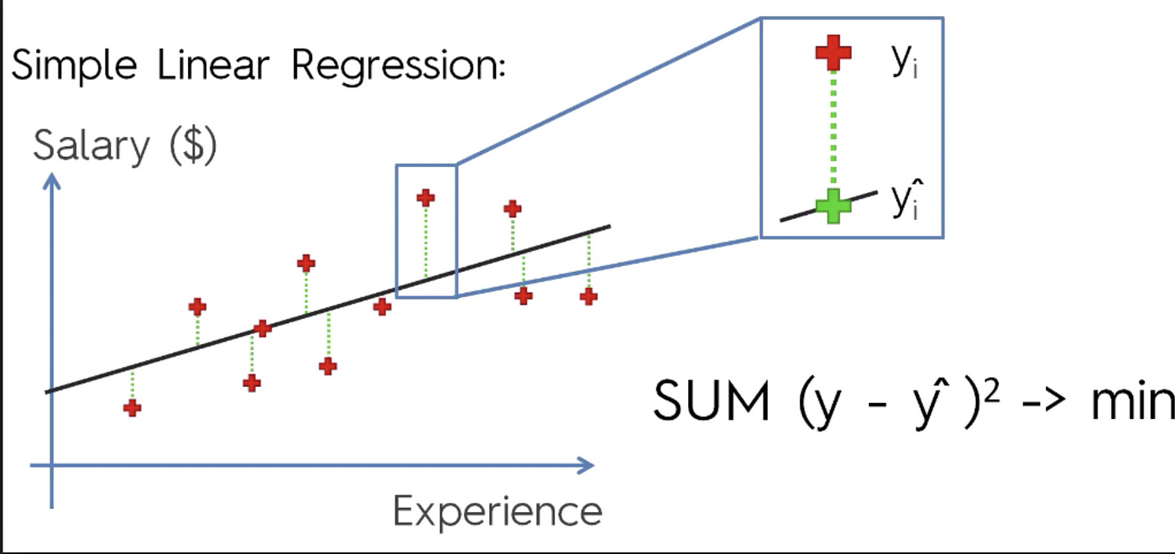

Cost Function - Mean Squared Error
Measuring Prediction Quality
The Mean Squared Error (MSE) quantifies how well our model performs.
Formula:
Key Points:
Lower MSE = Better model performance
Units are squared (e.g., dollars² for price prediction)
Always positive (due to squaring)
Heavily penalizes large errors

Slide 15
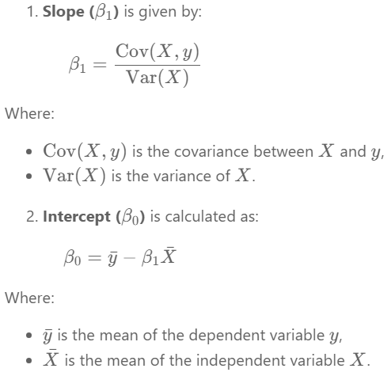

Solving Linear Regression with the Closed-Form Solution
The closed-form solution is efficient for small to medium-sized datasets, especially in simple linear regression, where slope and intercept can be computed directly without matrix operations.
However, for multiple linear regression, the closed-form solution involves computing the inverse of X^T.X, which becomes computationally expensive as dataset size and dimensionality grow.
It works well when:
The dataset is small (typically up to a few thousand rows).
The number of features is low.
There is no multicollinearity (i.e., features are not highly correlated).
For larger or more complex problems, iterative methods like Gradient Descent are preferred due to their scalability and efficiency.

Slide 16
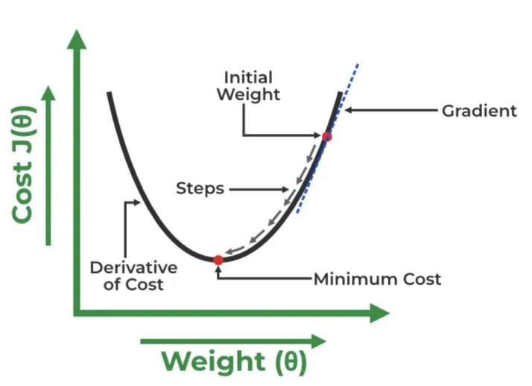
Solving Linear Regression Using The Gradient Descent Method
A linear regression model can be trained using Gradient Descent, which adjusts the model's parameters to minimize the mean squared error (MSE).
To update (Beta 0) and (Beta 1) and reduce the cost function (minimizing the RMSE), gradient descent starts with random values for (Beta 0) and (Beta 1) and iteratively improves them to find the best-fit line.
A gradient is simply the derivative, showing how small changes in inputs affect the output.
By moving in the direction of the Mean Squared Error negative gradient with respect to the coefficients, the coefficients can be changed.

Slide 17
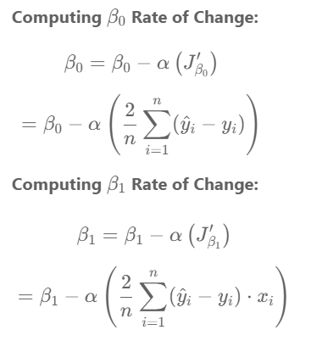
Solving Linear Regression Using The Gradient Descent Method

Slide 18
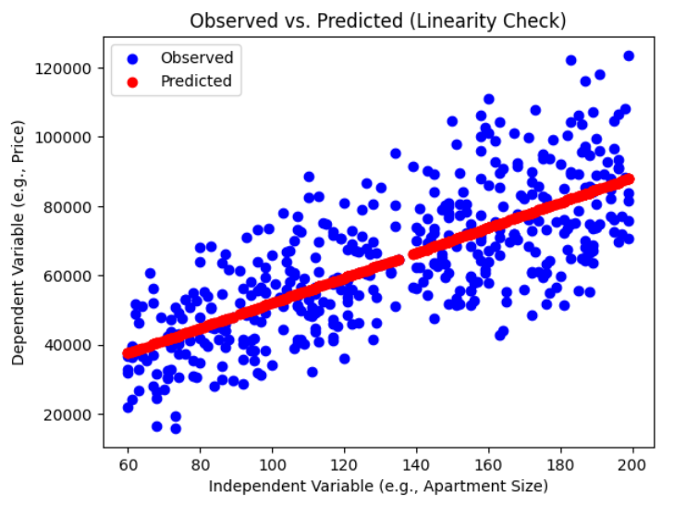
Assumptions of Simple Linear Regression
Linear regression is a powerful tool for understanding and predicting the behavior of a variable; however, it needs to meet a few conditions to be accurate and dependable solutions.
1. Linearity:
The independent and dependent variables have a linear relationship with one another.
This implies that changes in the dependent variable follow those in the independent variable(s) in a linear fashion.
This means that there should be a straight line that can be drawn through the data points.
If the relationship is not linear, then linear regression will not be an accurate model.

Slide 19
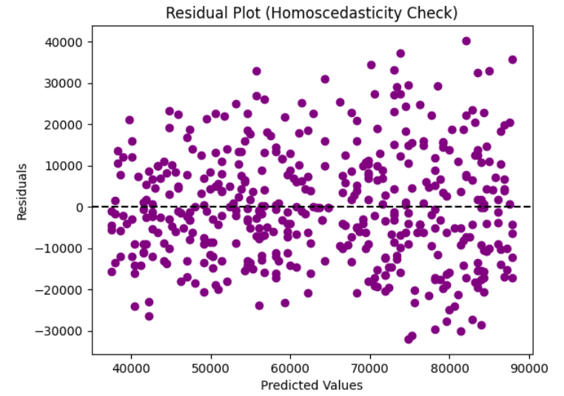
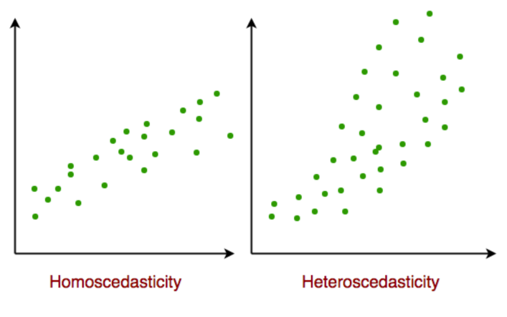
Assumptions of Simple Linear Regression
2. Independence: The observations in the dataset must be independent, meaning the value of the dependent variable for one observation should not be influenced by the value of another. If this condition is violated, linear regression may produce inaccurate results.
3. Homoscedasticity: The variance of the errors should be constant across all levels of the independent variable(s). This means that changes in the independent variable(s) should not affect the spread of the errors. If the error variance is not constant (heteroscedasticity), the linear regression model may not be reliable.

Slide 20
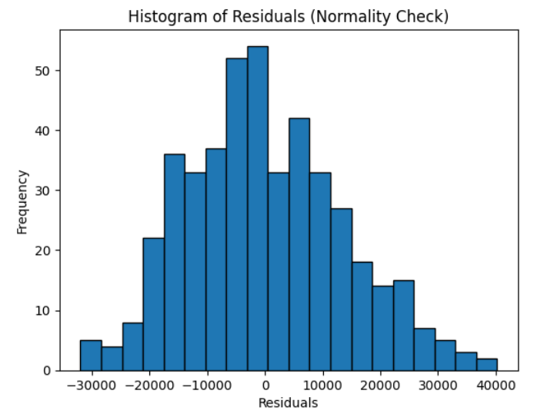
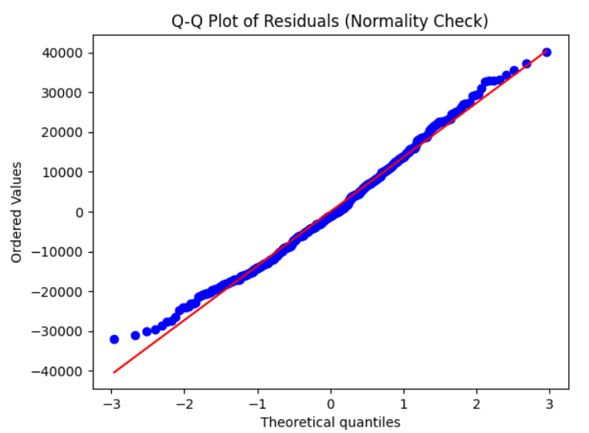
Assumptions of Simple Linear Regression
4. Normality: The residuals should be normally distributed. This means that the residuals should follow a bell-shaped curve. If the residuals are not normally distributed, then linear regression will not be an accurate model.

Slide 21
Assumptions of Simple Linear Regression
5. No Multicollinearity
The independent variables should not be highly correlated with each other.
Multicollinearity occurs when two or more independent variables are strongly related, making it difficult to isolate the effect of each variable on the dependent variable.
If multicollinearity exists, it can lead to inaccurate results in multiple linear regression.
For multiple linear regression, multicollinearity among independent variables can be assessed using the Variance Inflation Factor (VIF). A VIF value greater than 10 indicates high multicollinearity.

Slide 22
Implement Regression in Python

Slide 23
Import the Required Libraries
import numpy as np
import pandas as pd
import matplotlib.pyplot as plt
# import the required machine learning libraries
from sklearn.linear_model import LinearRegression
from sklearn.model_selection import train_test_split
from sklearn.metrics import r2_score
df = pd.read_csv('https://raw.githubusercontent.com/msfasha/307304-Data-Mining/refs/heads/main/20242/datasets/apartment_prices.csv')
print(f"Number of rows in the dataset: {len(df)}")
df.head(3)

Slide 24
Splitting the Data
Split to x and y
x = df.iloc[:, 0].values.reshape(-1, 1) # Reshape x to be a 2D array
y = df.iloc[:, -1].values # y can remain as a 1D array
# x = df["Square_Area"]
# y= df["Price"]
Split to train and test
# Splitting the dataset into training and test set.
x_train, x_test, y_train, y_test= train_test_split(x, y, test_size= .1, random_state=0)

Slide 25
Create the Regression Model and Train it
Create the Machine Learning model and make any required configurations
regressor= LinearRegression()
Train the model and print the learnt coefficients
regressor.fit(x_train, y_train)
print(regressor.coef_)
print(regressor.intercept_)
[362.33639889] 15802.319376714753
Make Predictions
# Make predictions using the training dataset
train_predictions= regressor.predict(x_train)

Slide 26
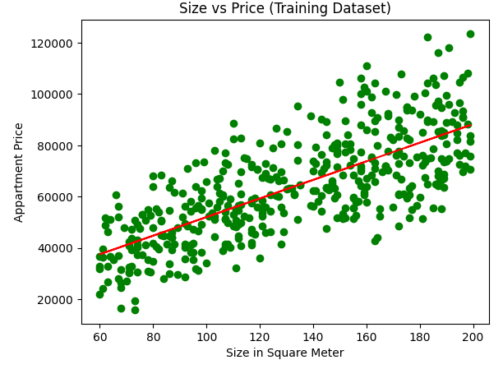
Show Prediction Plot
# plot the training data with the original dependent variable
plt.scatter(x_train, y_train, color="green")
# plot the training data with the predictions
plt.plot(x_train, train_predictions, color="red")
plt.title("Size vs Price (Training Dataset)")
plt.xlabel("Size in Square Meter")
plt.ylabel("Appartment Price")
plt.show()
Evaluate the model using R-Squared metric:
r2 = r2_score(y_train, train_predictions)
r2 = round(r2,2)
print("r2 score: ", r2)
r2 score: 0.55

Slide 27
Full Code
df = pd.read_csv('https://raw.githubusercontent.com/msfasha/307304-Data-Mining/refs/heads/main/20242/datasets/apartment_prices.csv')
x = df.iloc[:, 0].values.reshape(-1, 1) # Reshape x to be a 2D array
y = df.iloc[:, -1].values # y can remain as a 1D array
# Splitting the dataset into training and test set.
x_train, x_test, y_train, y_test= train_test_split(x, y, test_size= .1, random_state=0)
# Create the LinearRegression Model
regressor= LinearRegression()
# Train the model
regressor.fit(x_train, y_train)
# Print the results
print("Study Hours Coefficient: ", regressor.coef_)
print("Intercept Value: ", regressor.intercept_)
print("r2 score: ", round(r2_score(y_train, train_predictions),2))

